Slide 1

Java 12 Feature

Slide 2
1 New String and Files methods1.1 String.indent()
1.2 String.transform()
1.3 Files.mismatch()
2 The Teeing Collector
3 Support for Compact Number Formatting
4 Performance Improvements4.1 Default CDS Archives
4.2 Abortable Mixed Collections for G1
4.3 Promptly Return Unused Committed Memory from G1
5 Experimental and Preview Features5.1 Switch Expressions (Preview)
5.2 Shenandoah: A Low-Pause-Time Garbage Collector (Experimental)
6 Other Changes in Java 12 (Which You Don’t Necessarily Need to Know as a Java Developer)6.1 Unicode 11
6.2 Microbenchmark Suite
6.3 JVM Constants API
6.4 One AArch64 Port, Not Two
6.5 Complete List of All Changes in Java 12
7 Summary

Slide 3
New String and Files methods
String.indent()
String.transform()
Files.mismatch()

Slide 4
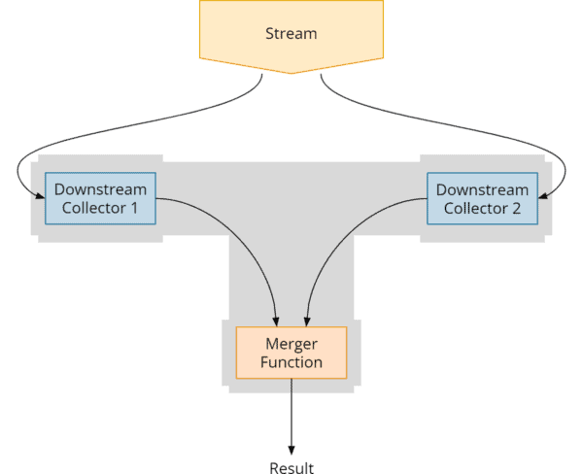
The Teeing Collector

Slide 5
Support for Compact Number Formatting
Using the static method NumberFormat.getCompactNumberInstance(), we can create a formatter for the so-called "compact number formatting". This is a form that is easy for humans to read, such as "2M" or "3 billion".
The Teeing Collector

Slide 6
Performance Improvements
Default CDS Archives
In the article on Java 10, you can find an introduction to Class-Data Sharing (CDS).
To enable class data sharing, you previously had to run java -Xshare:dump once for each Java installation to generate the classes.jsa shared archive file.
With the JDK Enhancement Proposal 341, all 64-bit ports of the JDK are now shipped with this file included so that the execution of java -Xshare:dump is no longer necessary and Java applications use the default CDS archive by default.
Abortable Mixed Collections for G1
JDK Enhancement Proposal 344 optimizes the Mixed Collections to split the collection set into a mandatory and an optional part if the maximum pause time is repeatedly exceeded. The mandatory part is executed uninterruptibly – and the optional part in small steps until the maximum pause time is reached.
Promptly Return Unused Committed Memory from G1
JEP 346 provides a solution to this problem. When the application is inactive, a parallel garbage collection cycle is started periodically, releasing any memory that may no longer be needed.
Batch processing example
This feature is disabled by default. You can enable it by specifying an interval in milliseconds in which G1 should check whether such a cycle should be started via the -XX:G1PeriodicGCInterval parameter.

Slide 7
Experimental and Preview Features
Switch Expressions (Preview) which is now production ready feature in Java 17.
Shenandoah: A Low-Pause-Time Garbage Collector

